Slide 1
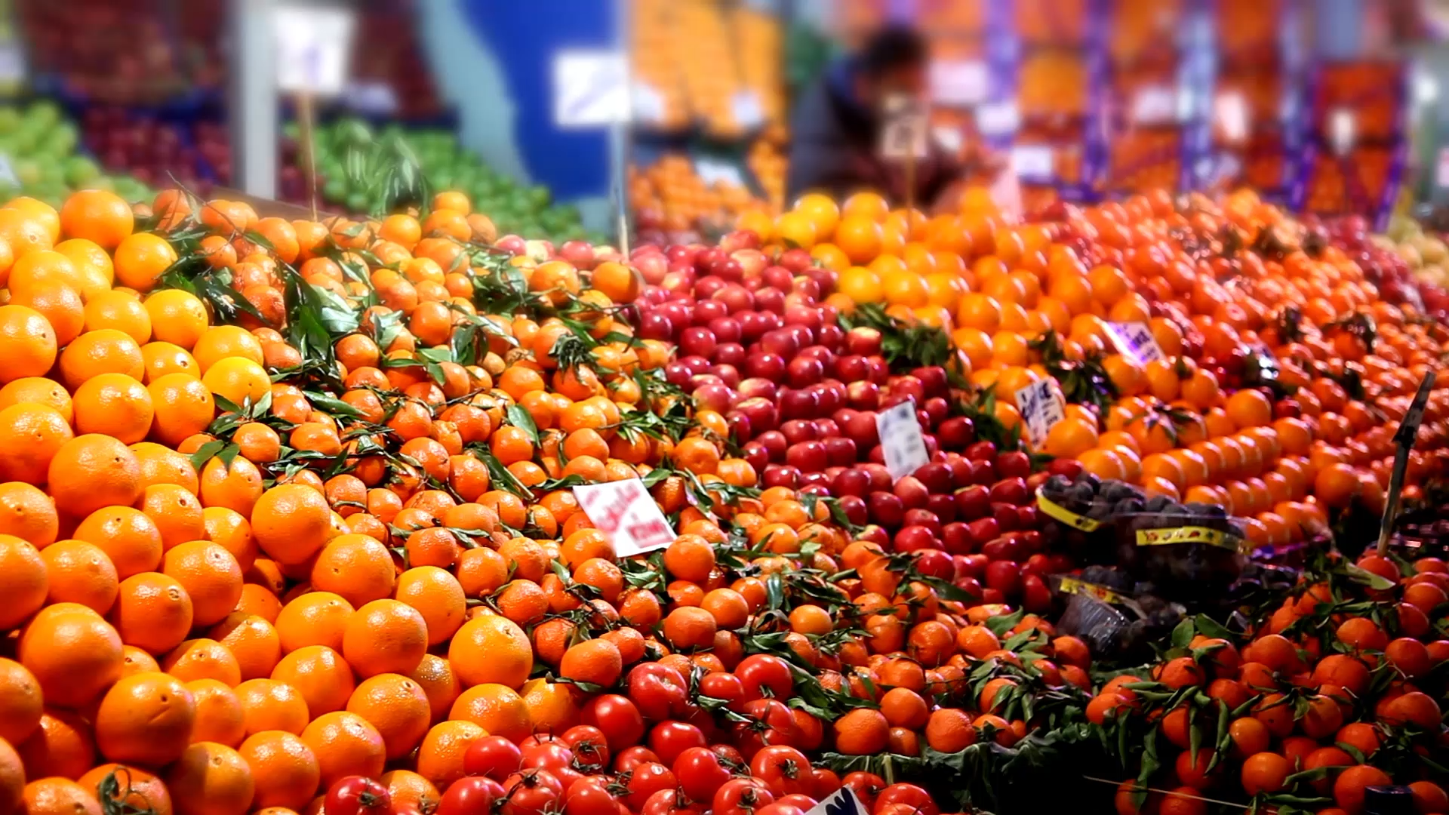

Battling Food Waste in Retail-Stores
--Predicting Retail-Stores Demand based on date of the year
Team JSS
Sai, Sohail, Jacky

Slide 2
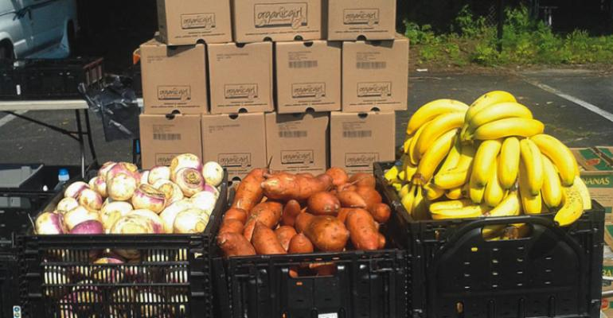
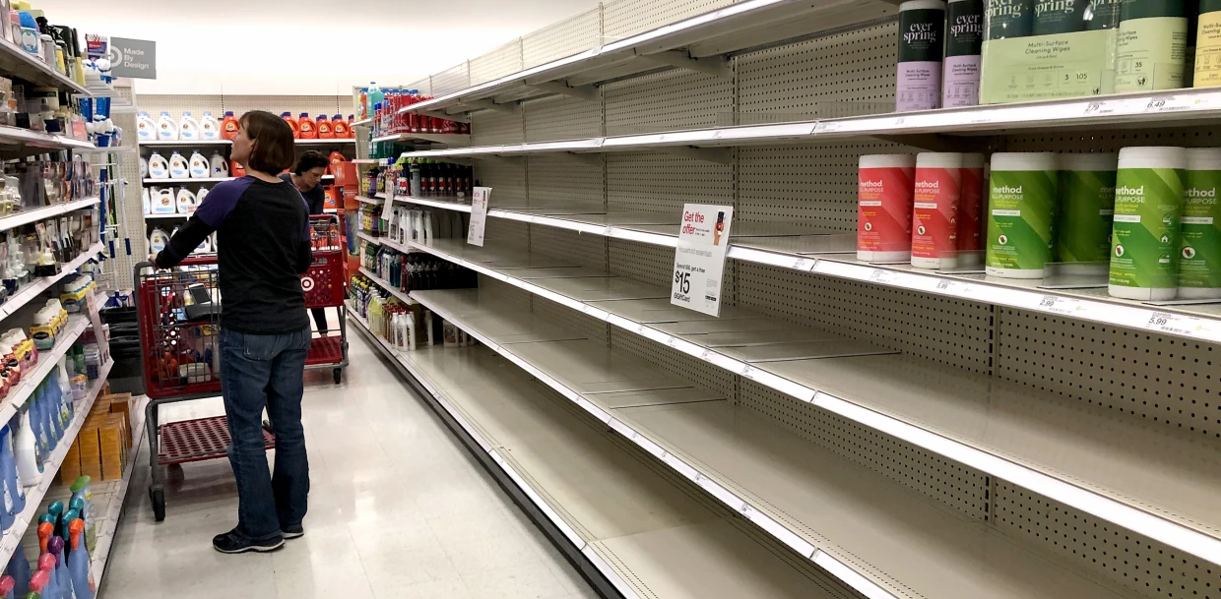
Consumer behaviors are sometimes unexpected
Demand for different items varies at different points in time.
Various external factors affect the demand.
Notes:
We all remember in the peak of pandemic, many shelves are empty as the upper picture shows; while at the same time, overstages on some food happened. A study of consumer behavior in Denmark, Germany, and Slovenia points out that people of these three countries shop less frequently during pandemic, and there was an increase in frozen food but a

Slide 3
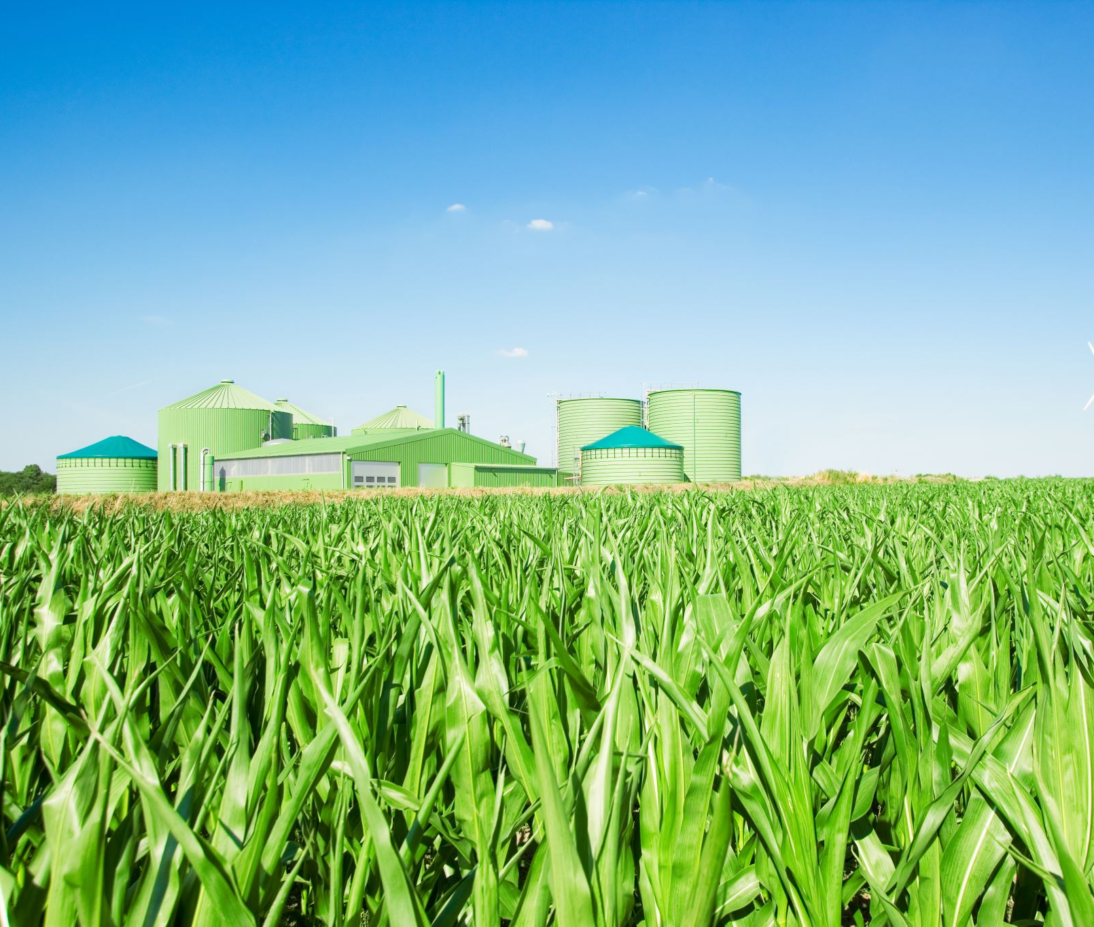
Most of the wastage comes from the perishable food being not consumed on time.
Demand Forecasting helps in optimizing the inventory for maximum utilization.
Reduction in waste has monetary and environmental benefits.
170 million metric tons of CO₂ emissions - 42 coal powered plants !
Notes:
Wasting food wastes money, along with the water and energy it took to produce that food. Agriculture accounts for 9 percent of greenhouse gas emissions in the US, and those climate impacting gases are even more senseless when the food is wasted. According to the National Resources Defense Council (NRDC), one in four Americans struggle with food insecurity and the impacts of climate change are worsening, this is not food we can afford to waste.
Reduce methane emissions by cutting down on landfills.
Perishable = Vegetable,Fruit,Dairy and Cereal.
The biggest concerns for most retail stores when it comes to donations are finding the right partners for distribution and transportation

Slide 4
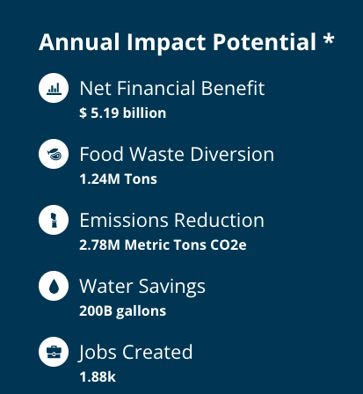
Enhance Demand Planning is the best solution!
Retail stores have the biggest influence on food demand connecting producers and suppliers to consumers.
Data from https://refed.org/

Slide 5

Methodology
Dataset:
Data Source: Store Demand Forecasting from Kaggle
Data Size: 931,000 entries
Data Spread: 1st January 2013 to 31st December 2017
Methods:
Visualization of test data; analyze possible trends
Train test data to Xgboost model

Slide 6
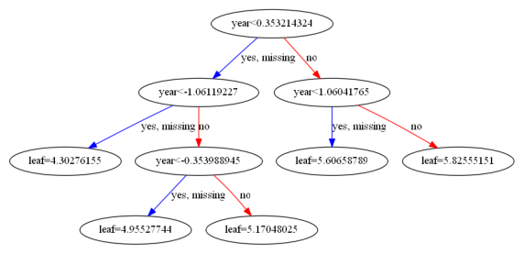
Result for the model
XGboost RMSE: 8.35
Weekly avg and monthly avg are most important when it comes to predicting sales values.

Slide 7

Social Impact and Feasibility
Financial benefits : Government, Retailers and Consumers
Food Security : Ensuring all people have access to food
Environmental Benefits
Stores have a lot of items but we target perishable food items as they are a major source of concern.
Currently a lot of stores do inventory management manually making them hard which is hard to manage and scale.

Slide 8

Future Plans
Using real time streaming data for accurate predictions
Optimizing the model
Targeting the food wastage at household level

Slide 9

Thank You

